Slide 1
Forecasting Boise Property Values
By: Michael Holthouser

Slide 2
Overview
Business Understanding
Recommended Strategy
Modeling
Time Series Modeling
Top 5 Zip Codes
Conclusion
Future Work

Slide 3
Business Understanding
Stakeholder:
World Wide Real Estate Investments
Business Question:
What are the top 5 Zip Codes to invest in Idaho?
Recommended Strategy:
Target zip codes in Boise, Idaho.

Slide 4
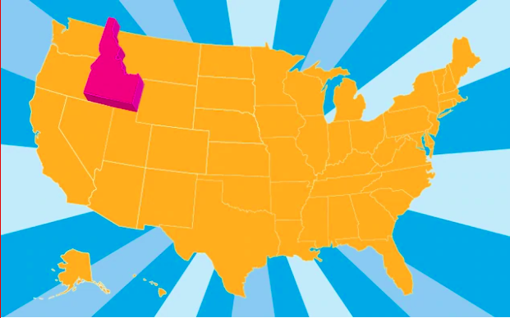

Slide 5
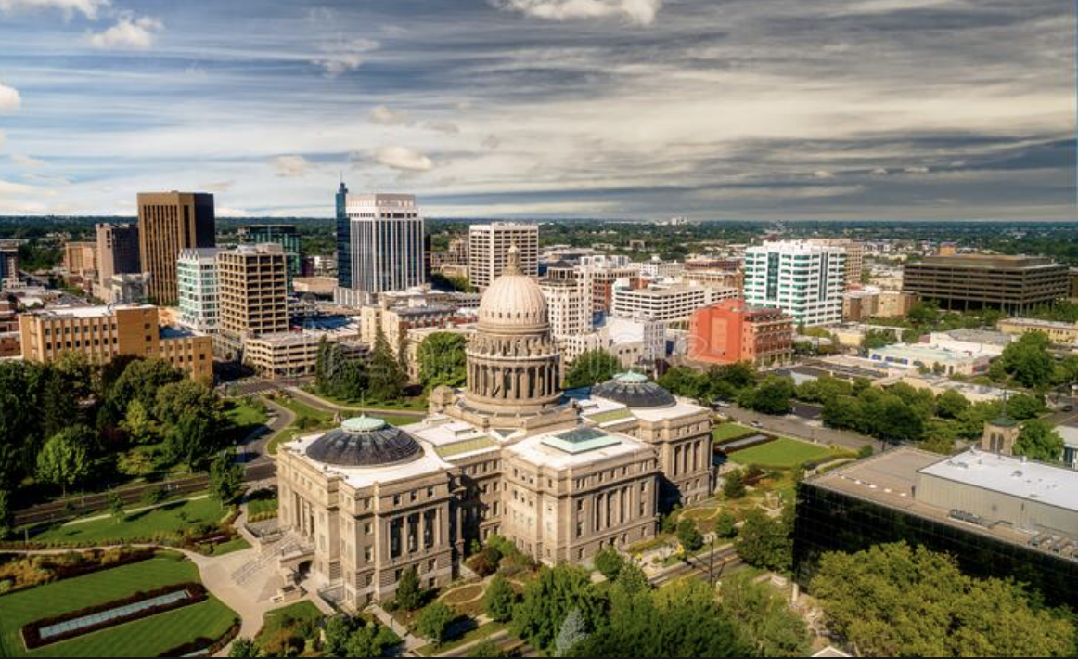
Recommended Strategy
Why invest in Boise, Idaho?
Population growth
Job opportunities
Existing infrastructure

Slide 6
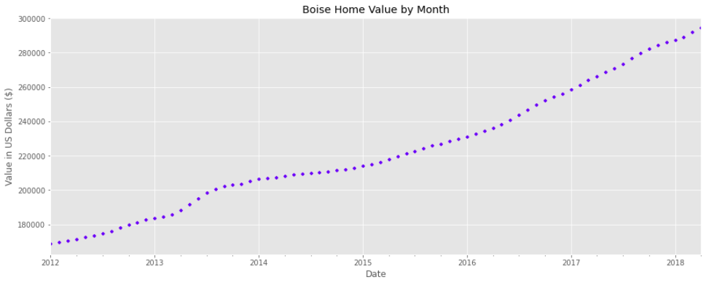
Time Series Modeling
Time Series is usually used to
predict future occurrences based
on previous observed occurrences
or values.

Slide 7
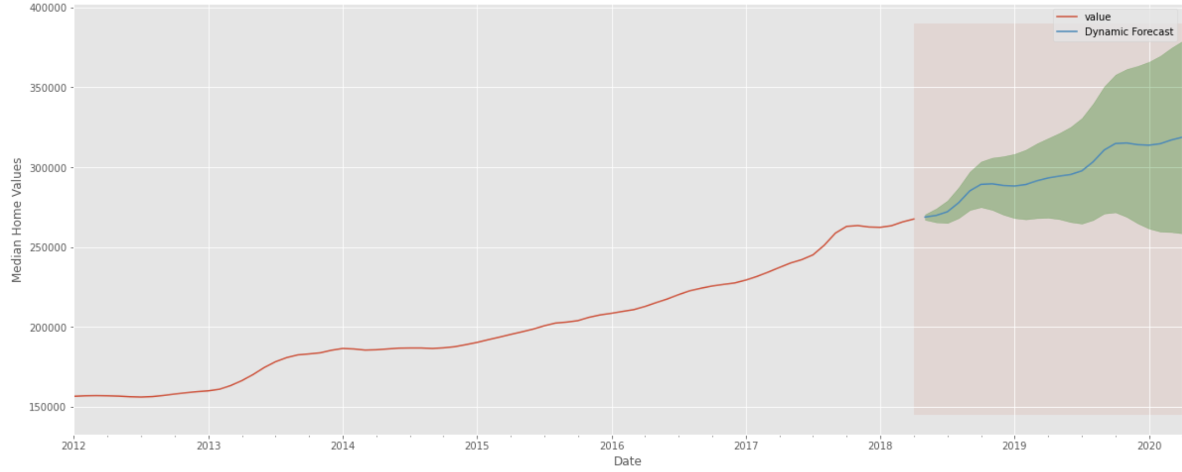
Top 5 Zip Codes
83706
18% 2 year ROI

Slide 8
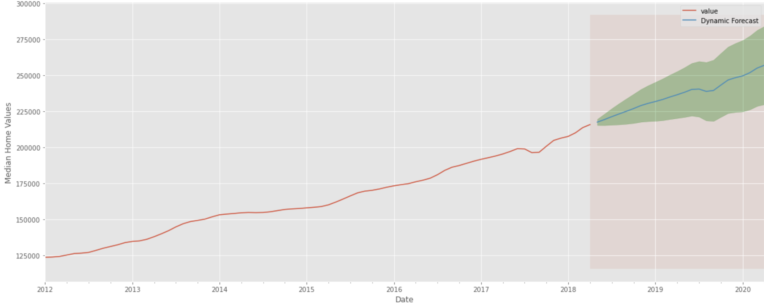
Top 5 Zip Codes
83704
18% 2 year ROI

Slide 9
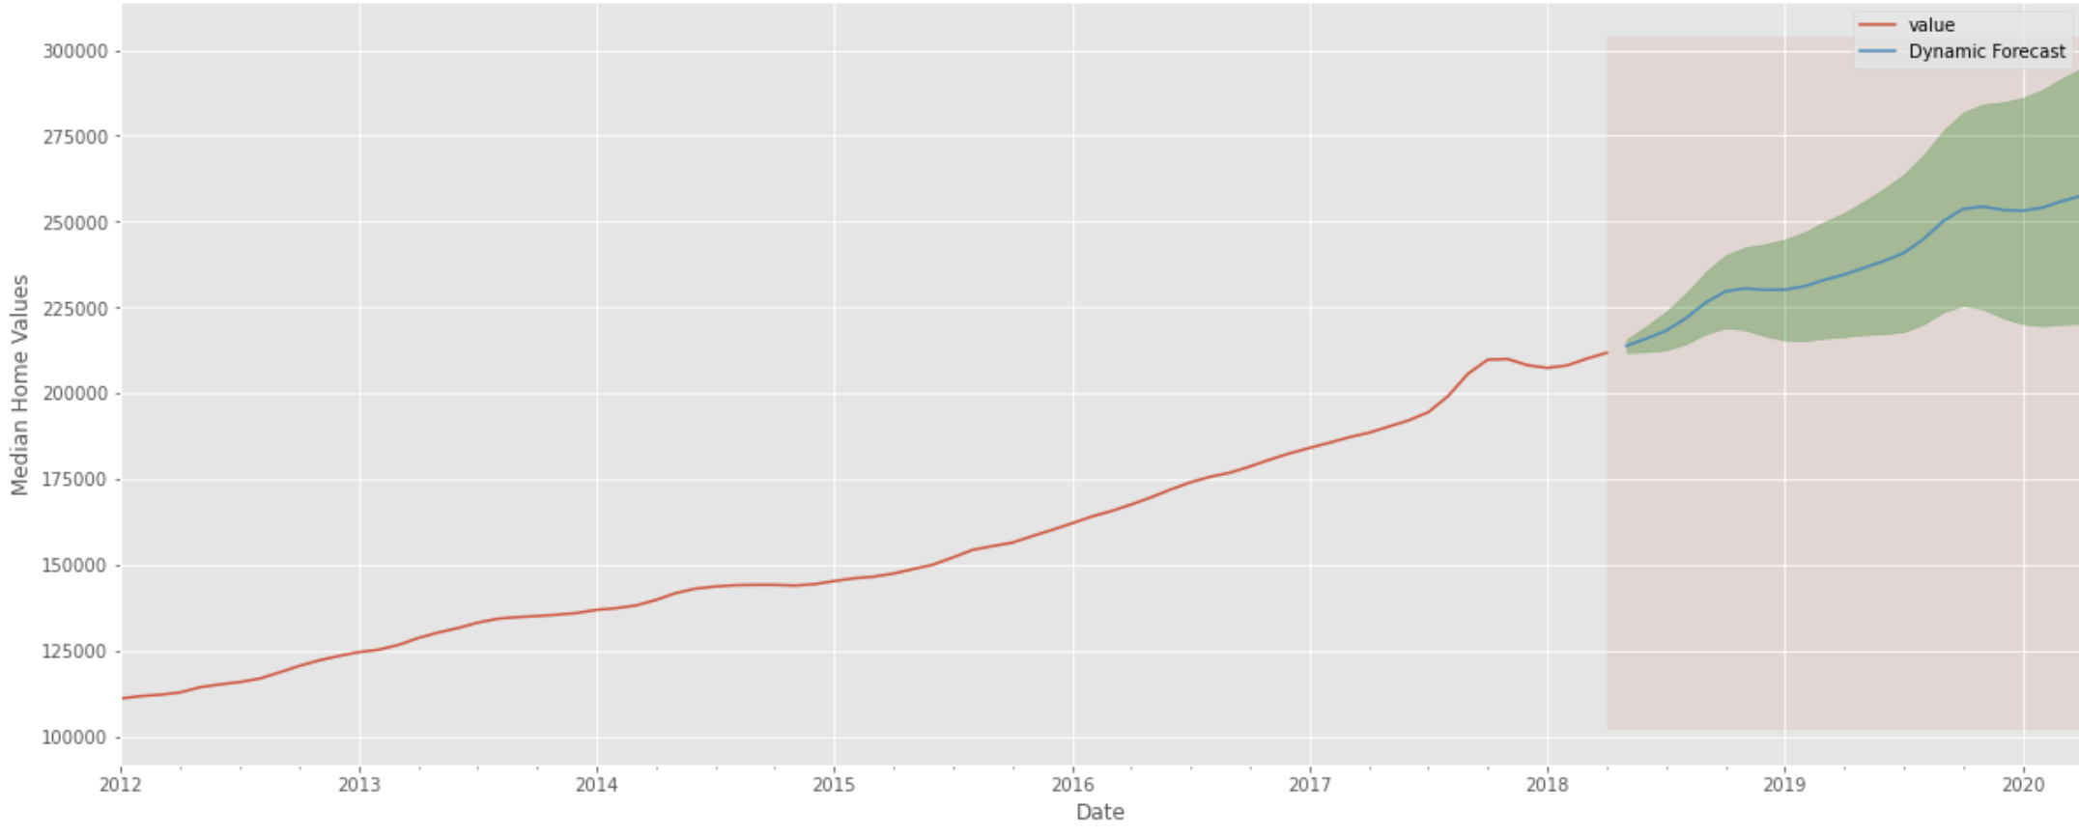
Top 5 Zip Codes
83705
20% 2 year ROI

Slide 10
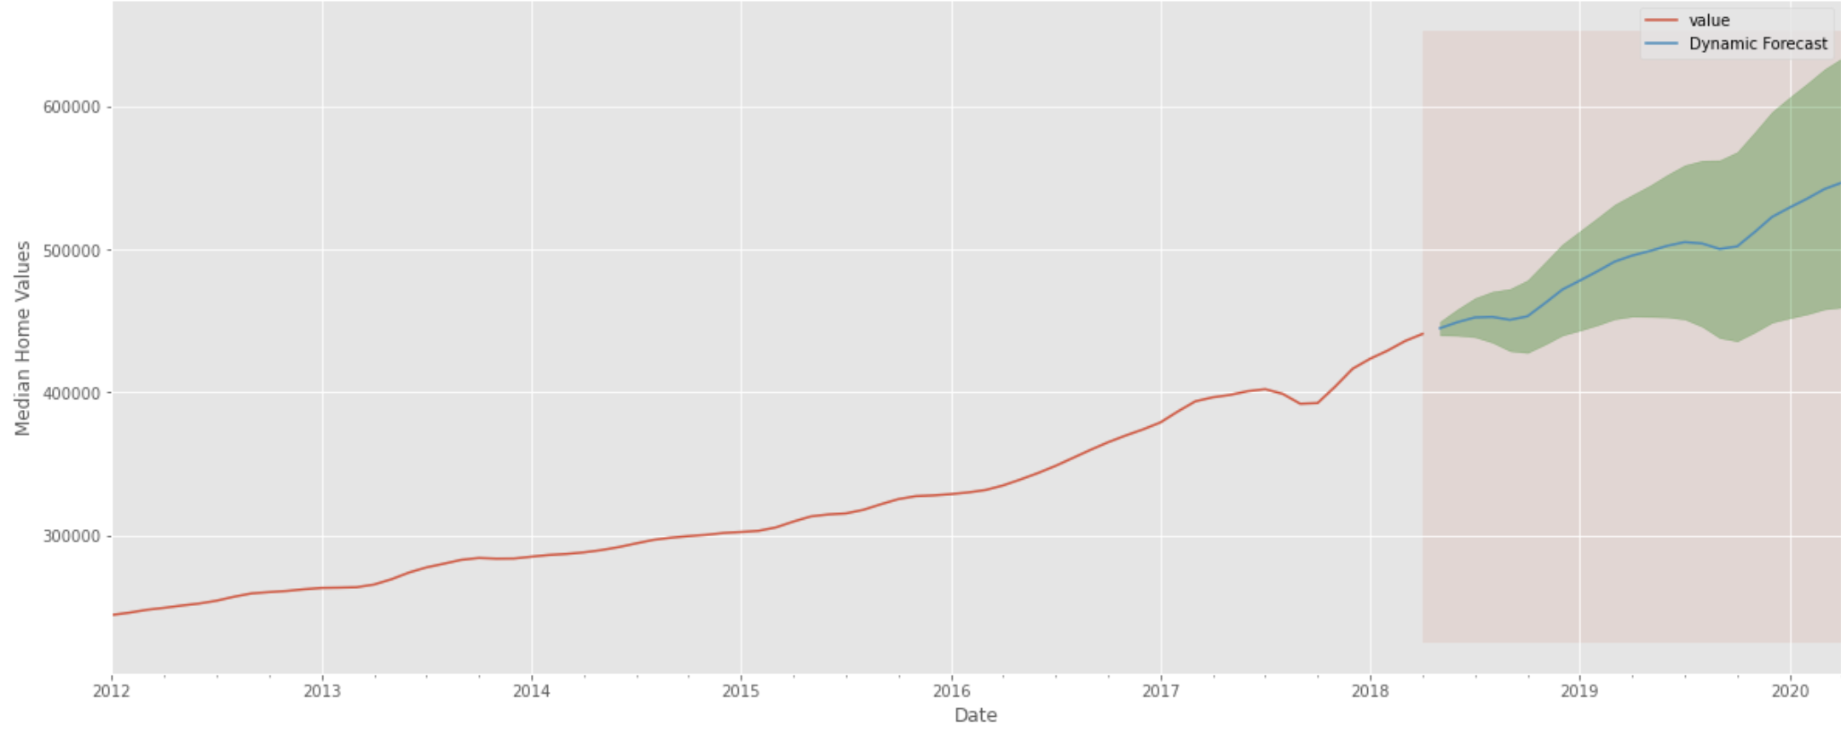
Top 5 Zip Codes
83702
22% 2 year ROI

Slide 11
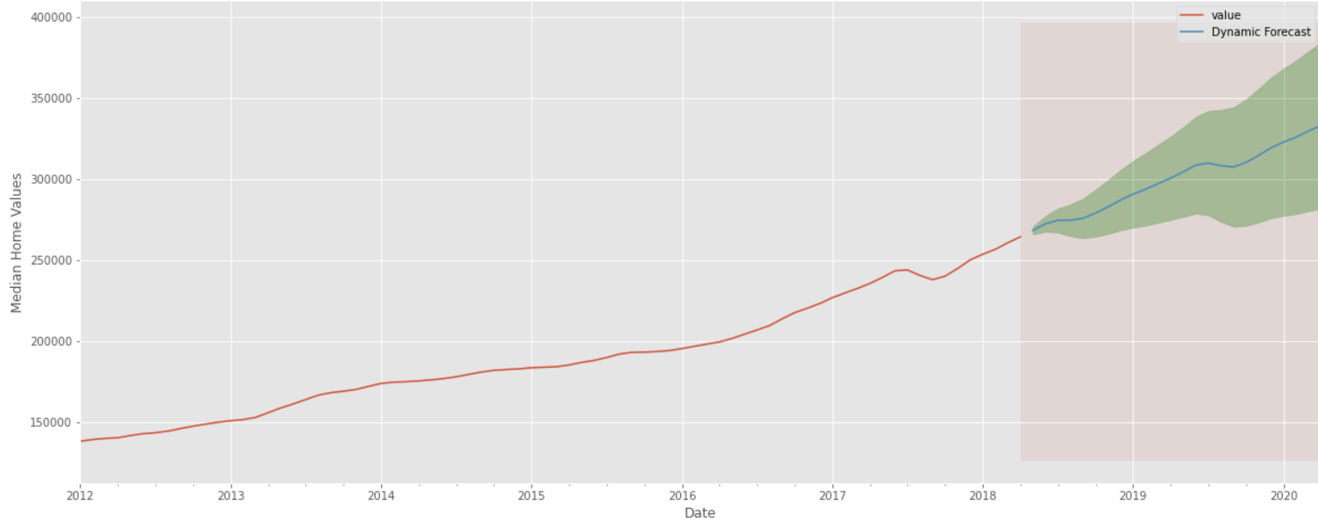
Top 5 Zip Codes
83703
24% 2 year ROI

Slide 12
Conclusion
83703: 24%
83702: 22%
83705: 20%
83704: 18%
83706: 18%
Recommendation:
83703 has a low initial investment with great forecasted returns.

Slide 13
Future Work
Investigate other parts of Idaho.
Compare the findings with Boise.
More revenue may create the need to model in other areas.
Continue to model Boise areas as new data is released.
Compare Idaho zip codes to other up and coming states.

Slide 14


Thank you
Michael Holthouser
Mholthouser.co@gmail.com
https://github.com/MHolthouser1024/phase4_zillow_project

